Slide 1
Data structures
Nagulesh N [ 22BCS071 ]

Slide 2
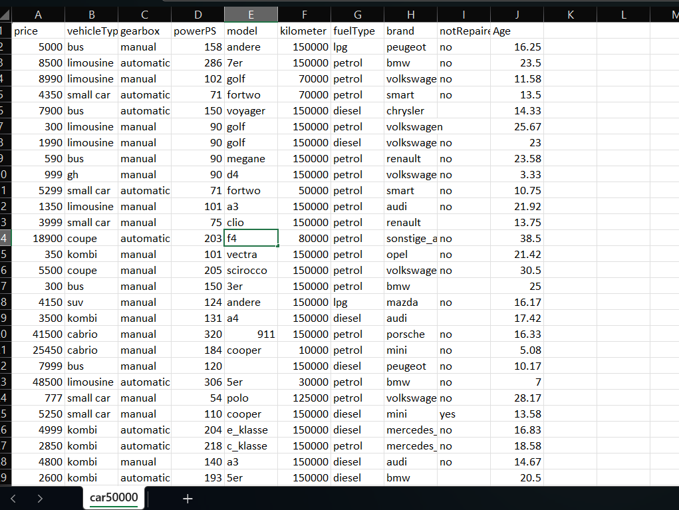

Data set on vehicle service management
I took this data set from kaggle
In this data set, I took first column price as my input to the sorting array
This dataset consists 50,500 dataset rows ,It consists of 31,230 unique elements.
Nagulesh N [ 22BCS071 ]

Slide 3
Insertion sort
#include <stdio.h>
#include <stdlib.h>
#include <string.h>
#include <time.h>
#define MAX_LINE_LENGTH 1024
#define MAX_ROWS 50000
int main() {
FILE *file;
char line[MAX_LINE_LENGTH];
char *column[MAX_ROWS];
int row_count = 0;
file = fopen("C:\\Users\\nagul\\Desktop\\Data structure\\car50000.csv", "r");
if (file == NULL) {
perror("Error opening file");
return 1;
}
while (fgets(line, sizeof(line), file) != NULL && row_count < MAX_ROWS) {
line[strcspn(line, "\n")] = '\0';
char *token = strtok(line, ",");
if (token != NULL) {
column[row_count] = strdup(token);
row_count++;
}
}
Nagulesh N [ 22BCS071 ]

Slide 4
int n = sizeof(column)/sizeof(column[0]);
char *endptr;
int record[MAX_ROWS];
for (int i = 0; i < row_count; i++) {
int num = strtol(column[i], &endptr, 10);
record[i] = num ;
} clock_t start_time = clock();
int i,j, key;
for (int i = 1; i < n; i++) {
key = record[i];
j = i - 1;
while (j >= 0 && record[j] > key) {
record[j + 1] = record[j];
j = j - 1;
}
record[j + 1] = key;
} }
clock_t end_time = clock();
for (int i = 0; i < row_count; i++) {
printf(“Element %d: %d\n", i + 1, record[i]);
free(column[i]);
}
printf(“Insertion sort for %d sets \n",i);
double time_taken = ((double)(end_time - start_time)) /
CLOCKS_PER_SEC;
printf("Time taken: %f seconds\n", time_taken);
fclose(file);
return 0;
}
Nagulesh N [ 22BCS071 ]

Slide 5
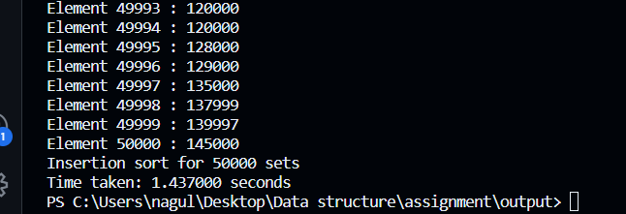
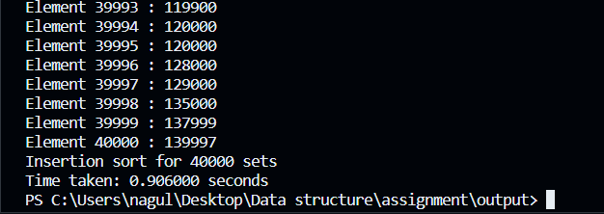
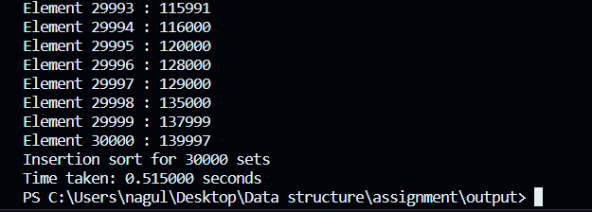
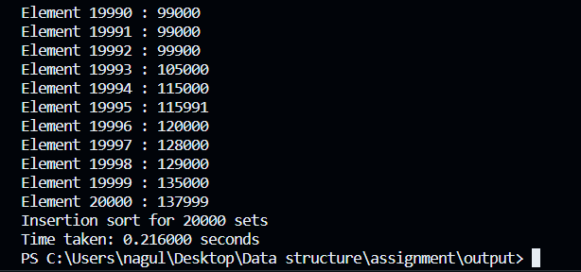
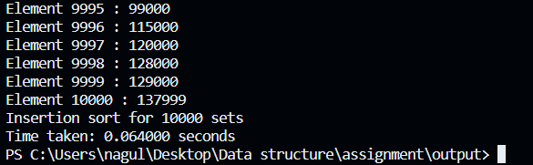
code outputs
50000 datasets
40000 datasets
30000 datasets
20000 datasets
10000 datasets
Nagulesh N [ 22BCS071 ]

Slide 6
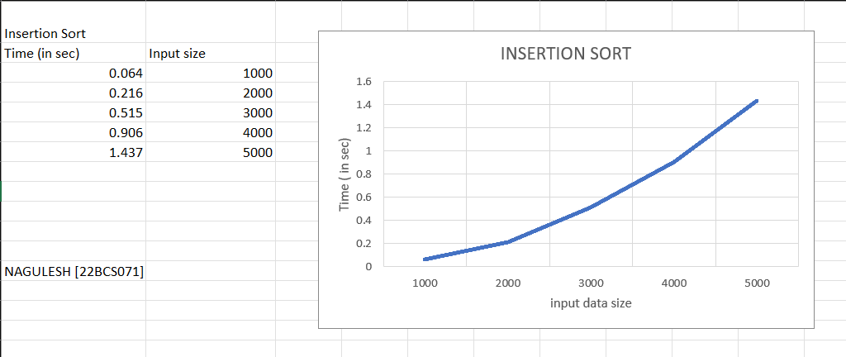
Graph [ insertion sort ]
Nagulesh N [ 22BCS071 ]

Slide 7
bubble sort
#include <stdio.h>
#include <stdlib.h>
#include <string.h>
#include <time.h>
#define MAX_LINE_LENGTH 1024
#define MAX_ROWS 50000
int main() {
FILE *file;
char line[MAX_LINE_LENGTH];
char *column[MAX_ROWS];
int row_count = 0;
file = fopen("C:\\Users\\nagul\\Desktop\\Data structure\\car50000.csv", "r");
if (file == NULL) {
perror("Error opening file");
return 1;
}
while (fgets(line, sizeof(line), file) != NULL && row_count < MAX_ROWS) {
line[strcspn(line, "\n")] = '\0';
char *token = strtok(line, ",");
if (token != NULL) {
column[row_count] = strdup(token);
row_count++;
}
}
Nagulesh N [ 22BCS071 ]

Slide 8
int n = sizeof(column)/sizeof(column[0]);
char *endptr;
int record[MAX_ROWS];
for (int i = 0; i < row_count; i++) {
int num = strtol(column[i], &endptr, 10);
record[i] = num ;
} clock_t start_time = clock();
for (int i = 1; i < n; i++) {
key = record[i];
j = i - 1;
while (j >= 0 && record[j] > key) {
record[j + 1] = record[j];
j = j - 1;
}
record[j + 1] = key;
} }
clock_t end_time = clock();
for (int i = 0; i < row_count; i++) {
printf(“Element %d :%d\n", i + 1, record[i]);
free(column[i]);
}
printf(“Bubble sort for %d sets \n",i);
double time_taken = ((double)(end_time - start_time)) /
CLOCKS_PER_SEC;
printf("Time taken: %f seconds\n", time_taken);
fclose(file);
return 0;
}
Nagulesh N [ 22BCS071 ]

Slide 9
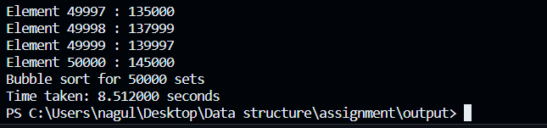
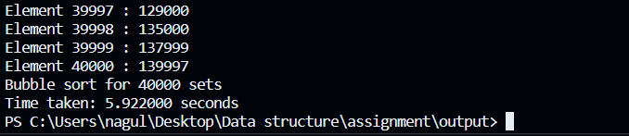
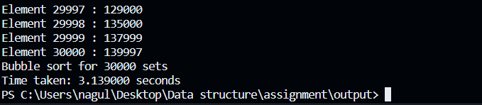
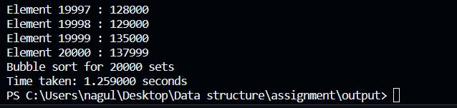
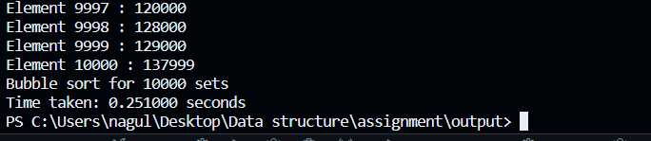
code outputs
50000 datasets
40000 datasets
30000 datasets
20000 datasets
10000 datasets
Nagulesh N [ 22BCS071 ]

Slide 10
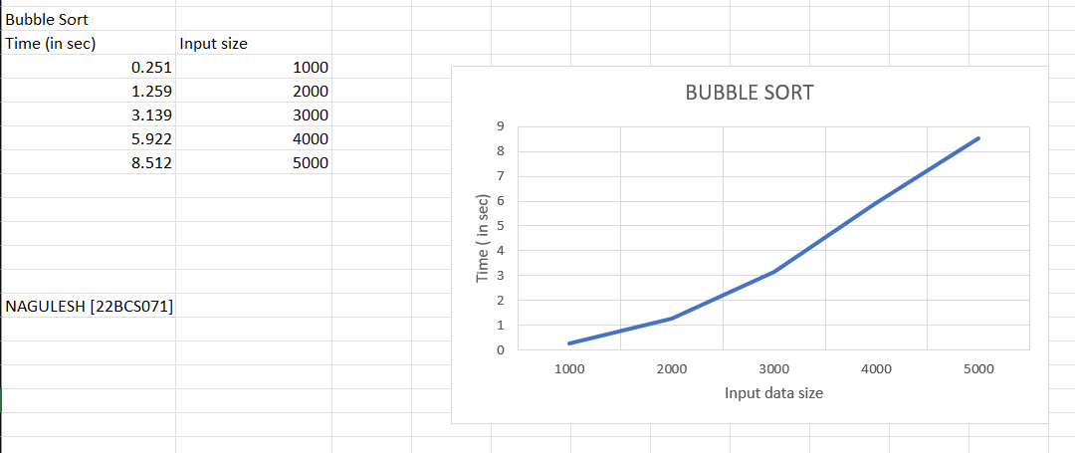
Graph [ bubble sort ]
Nagulesh N [ 22BCS071 ]

Slide 11
selection sort
#include <stdio.h>
#include <stdlib.h>
#include <string.h>
#include <time.h>
#define MAX_LINE_LENGTH 1024
#define MAX_ROWS 50000
void swap(int* a, int* b) {
int temp = *a;
*a = *b;
*b = temp;
}
int main() {
FILE *file;
char line[MAX_LINE_LENGTH];
char *column[MAX_ROWS];
int row_count = 0;
file = fopen("C:\\Users\\nagul\\Desktop\\Data structure\\car50000.csv", "r");
if (file == NULL) {
perror("Error opening file");
return 1;
}
while (fgets(line, sizeof(line), file) != NULL && row_count < MAX_ROWS) {
line[strcspn(line, "\n")] = '\0';
char *token = strtok(line, ",");
if (token != NULL) {
column[row_count] = strdup(token);
row_count++;
}
}
Nagulesh N [ 22BCS071 ]

Slide 12
int n = sizeof(column)/sizeof(column[0]);
char *endptr;
int record[MAX_ROWS];
for (int i = 0; i < row_count; i++) {
int num = strtol(column[i], &endptr, 10);
record[i] = num ;
} clock_t start_time = clock();
int i, j, min_index;
for (i = 0; i < n - 1; i++) {
min_index = i;
for (j = i + 1; j < n; j++) {
if (record[j] < record[min_index]) {
min_index = j;
}
}
swap(&record[i], &record[min_index]);
}
clock_t end_time = clock();
for (int i = 0; i < row_count; i++) {
printf(“Element %d :%d\n", i + 1, record[i]);
free(column[i]);
}
printf(“Selection sort for %d sets \n",i);
double time_taken = ((double)(end_time - start_time)) /
CLOCKS_PER_SEC;
printf("Time taken: %f seconds\n", time_taken);
fclose(file);
return 0;
}
Nagulesh N [ 22BCS071 ]

Slide 13
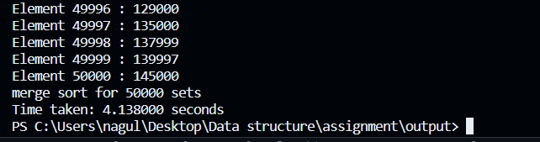
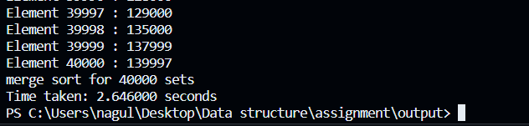
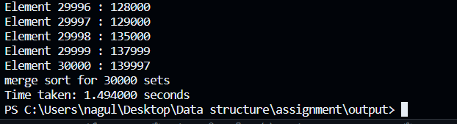
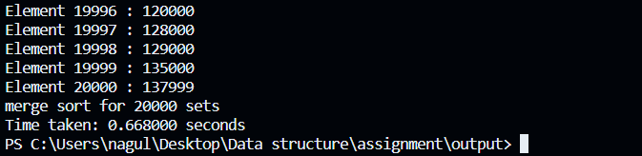
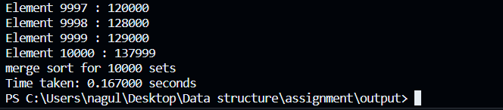
code outputs
50000 datasets
40000 datasets
30000 datasets
20000 datasets
10000 datasets
Nagulesh N [ 22BCS071 ]

Slide 14
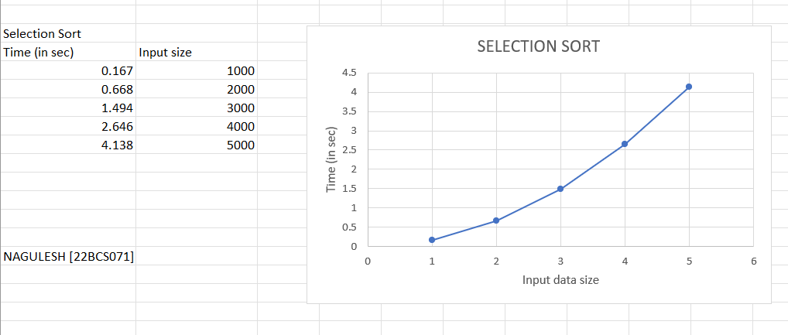
Graph [ Selection sort ]
Nagulesh N [ 22BCS071 ]

Slide 15
quick sort
#include <stdio.h>
#include <stdlib.h>
#include <string.h>
#include <time.h>
#define MAX_LINE_LENGTH 1024
#define MAX_ROWS 50000 void swap(int* a, int* b) {
int temp = *a;
*a = *b;
*b = temp;
}
int partition(int arr[], int low, int high) {
int pivot = arr[high];
int i = low - 1;
for (int j = low; j < high; j++) {
if (arr[j] < pivot) {
i++;
swap(&arr[i], &arr[j]);
}
}
swap(&arr[i + 1], &arr[high]);
return i + 1;
}
void quickSort(int arr[], int low, int high) {
if (low < high) {
int pi = partition(arr, low, high);
quickSort(arr, low, pi - 1);
quickSort(arr, pi + 1, high);
}
}
int main() {
FILE *file;
char line[MAX_LINE_LENGTH];
char *column[MAX_ROWS];
int row_count = 0;
file = fopen("C:\\Users\\nagul\\Desktop\\Data structure\\car50000.csv", "r");
if (file == NULL) {
perror("Error opening file");
return 1;
}
Nagulesh N [ 22BCS071 ]

Slide 16
while (fgets(line, sizeof(line), file) != NULL && row_count < MAX_ROWS) {
line[strcspn(line, "\n")] = '\0';
char *token = strtok(line, ",");
if (token != NULL) {
column[row_count] = strdup(token);
row_count++;
}
}
int n = sizeof(column)/sizeof(column[0]);
char *endptr;
int record[MAX_ROWS];
for (int i = 0; i < row_count; i++) {
int num = strtol(column[i], &endptr, 10);
record[i] = num ;
} clock_t start_time = clock();
quicksort(record,0,MAX_ROWS-1);
clock_t end_time = clock();
for (int i = 0; i < row_count; i++) {
printf(“Element %d : %d\n", i + 1, record[i]);
free(column[i]);
}
printf("Quick sort for %d sets \n",i);
double time_taken = ((double)(end_time - start_time)) /
CLOCKS_PER_SEC;
printf("Time taken: %f seconds\n", time_taken);
fclose(file);
return 0;
}
Nagulesh N [ 22BCS071 ]

Slide 17
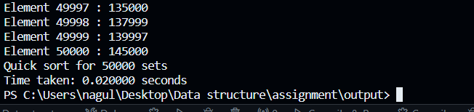
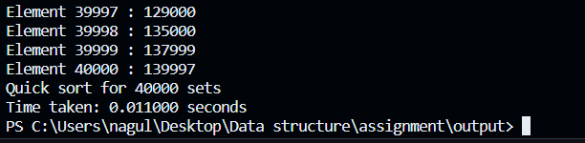
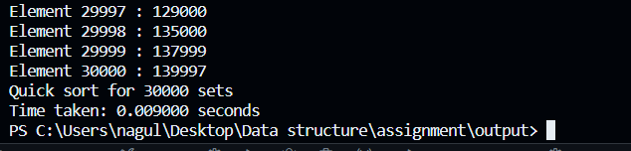
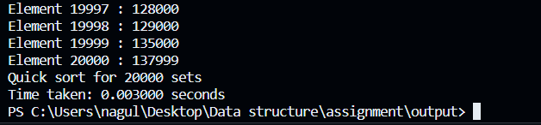
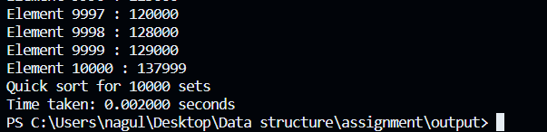
code outputs
50000 datasets
40000 datasets
30000 datasets
20000 datasets
10000 datasets
Nagulesh N [ 22BCS071 ]

Slide 18
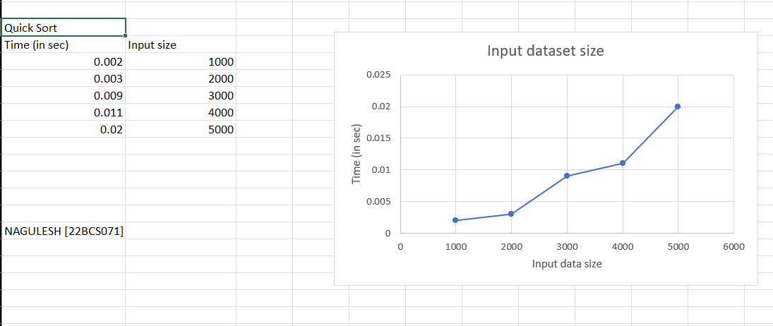
Graph [ quick sort ]
Nagulesh N [ 22BCS071 ]

Slide 19
heap sort
#include <stdio.h>
#include <stdlib.h>
#include <string.h>
#include <time.h>
#define MAX_LINE_LENGTH 1024
#define MAX_ROWS 50000 void swap(int* a, int* b) {
int temp = *a;
*a = *b;
*b = temp; }
void heapify(int arr[], int n, int i) {
int largest = i;
int left = 2 * i + 1;
int right = 2 * i + 2;
if (left < n && arr[left] > arr[largest])
largest = left;
if (right < n && arr[right] > arr[largest])
largest = right;
if (largest != i) {
swap(&arr[i], &arr[largest]);
heapify(arr, n, largest);
}
}
void heapSort(int arr[], int n) {
for (int i = n / 2 - 1; i >= 0; i--)
heapify(arr, n, i);
for (int i = n - 1; i > 0; i--) {
swap(&arr[0], &arr[i]);
heapify(arr, i, 0);
}
}
int main() {
FILE *file;
char line[MAX_LINE_LENGTH];
char *column[MAX_ROWS];
int row_count = 0;
file = fopen("C:\\Users\\nagul\\Desktop\\Data structure\\car50000.csv", "r");
if (file == NULL) {
perror("Error opening file");
return 1;
}
Nagulesh N [ 22BCS071 ]

Slide 20
while (fgets(line, sizeof(line), file) != NULL && row_count < MAX_ROWS) {
line[strcspn(line, "\n")] = '\0';
char *token = strtok(line, ",");
if (token != NULL) {
column[row_count] = strdup(token);
row_count++;
}
}
int n = sizeof(column)/sizeof(column[0]);
char *endptr;
int record[MAX_ROWS];
for (int i = 0; i < row_count; i++) {
int num = strtol(column[i], &endptr, 10);
record[i] = num ;
} clock_t start_time = clock();
heapsort(record,0,MAX_ROWS-1);
clock_t end_time = clock();
for (int i = 0; i < row_count; i++) {
printf(“Element %d : %d\n", i + 1, record[i]);
free(column[i]);
}
printf(“Heap sort for %d sets \n",i);
double time_taken = ((double)(end_time - start_time)) /
CLOCKS_PER_SEC;
printf("Time taken: %f seconds\n", time_taken);
fclose(file);
return 0;
}
Nagulesh N [ 22BCS071 ]

Slide 21
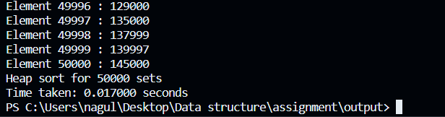
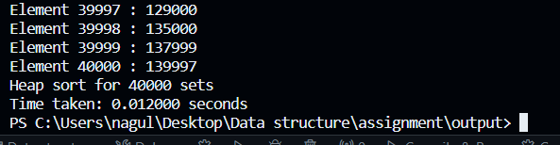
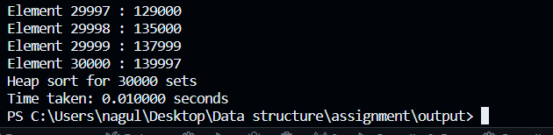
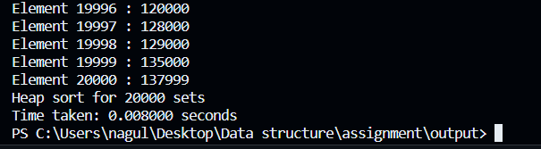
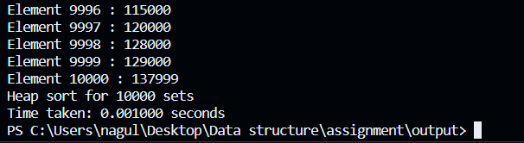
code outputs
50000 datasets
40000 datasets
30000 datasets
20000 datasets
10000 datasets
Nagulesh N [ 22BCS071 ]

Slide 22
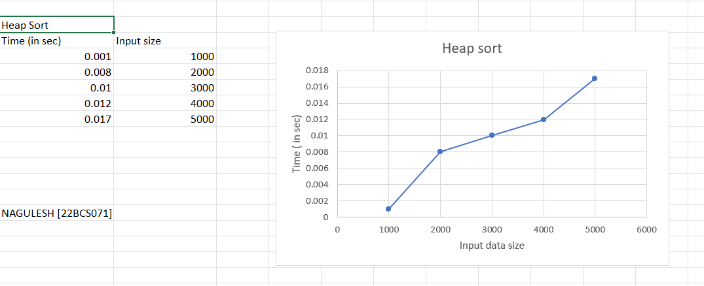
Graph [ heap sort ]
Nagulesh N [ 22BCS071 ]

Slide 23
merge sort
#include <stdio.h>
#include <stdlib.h>
#include <string.h>
#include <time.h>
#define MAX_LINE_LENGTH 1024
#define MAX_ROWS 50000 void merge(int arr[], int left, int mid, int right) {
int i, j, k;
int n1 = mid - left + 1;
int n2 = right - mid;
int L[n1], R[n2];
for (i = 0; i < n1; i++)
L[i] = arr[left + i];
for (j = 0; j < n2; j++)
R[j] = arr[mid + 1 + j];
i = 0;
j = 0;
k = left;
while (i < n1 && j < n2) {
if (L[i] <= R[j]) {
arr[k] = L[i];
i++;
}
else {
arr[k] = R[j];
j++; }
k++; }
while (i < n1) {
arr[k] = L[i];
i++;
k++; }
while (j < n2) {
arr[k] = R[j];
j++;
k++; }
}
void mergeSort(int arr[], int left, int right) {
if (left < right) {
int mid = left + (right - left) / 2;
mergeSort(arr, left, mid);
mergeSort(arr, mid + 1, right);
merge(arr, left, mid, right);
} }
Nagulesh N [ 22BCS071 ]

Slide 24
int main() {
FILE *file;
char line[MAX_LINE_LENGTH];
char *column[MAX_ROWS];
int row_count = 0;
file = fopen("C:\\Users\\nagul\\Desktop\\Data structure\\car50000.csv", "r");
if (file == NULL) {
perror("Error opening file");
return 1;
}
while (fgets(line, sizeof(line), file) != NULL && row_count < MAX_ROWS) {
line[strcspn(line, "\n")] = '\0';
char *token = strtok(line, ",");
if (token != NULL) {
column[row_count] = strdup(token);
row_count++;
} }
int n = sizeof(column)/sizeof(column[0]);
char *endptr;
int record[MAX_ROWS];
for (int i = 0; i < row_count; i++) {
int num = strtol(column[i], &endptr, 10);
record[i] = num ;
} clock_t start_time = clock();
heapsort(record,0,MAX_ROWS-1);
clock_t end_time = clock();
for (int i = 0; i < row_count; i++) {
printf(“Element %d : %d\n", i + 1, record[i]);
free(column[i]);
}
printf(“Merge sort for %d sets \n",i);
double time_taken = ((double)(end_time - start_time)) /
CLOCKS_PER_SEC;
printf("Time taken: %f seconds\n", time_taken);
fclose(file);
return 0;
}
Nagulesh N [ 22BCS071 ]

Slide 25
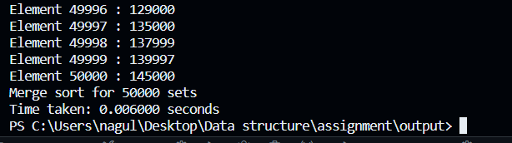
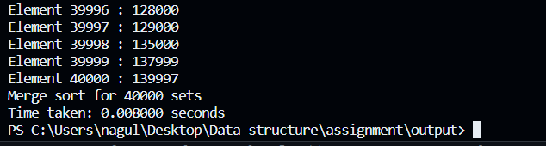
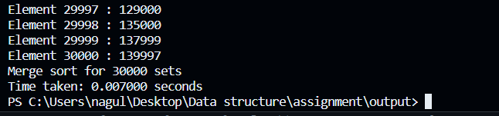
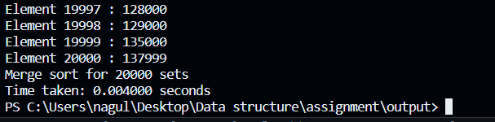
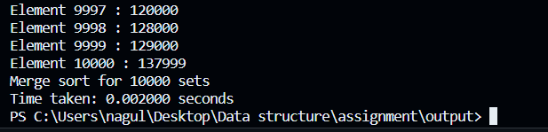
code outputs
50000 datasets
40000 datasets
30000 datasets
20000 datasets
10000 datasets
Nagulesh N [ 22BCS071 ]

Slide 26
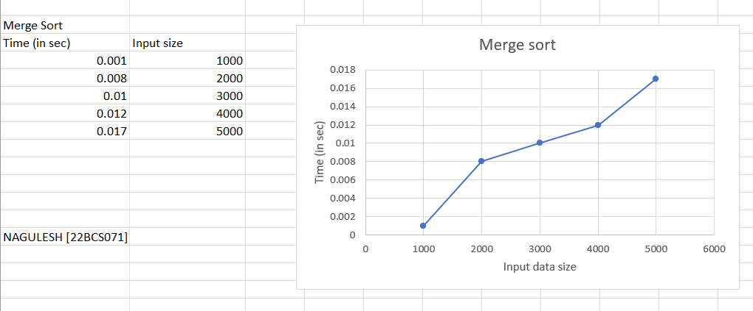
Graph [ merge sort ]
Nagulesh N [ 22BCS071 ]

Slide 27
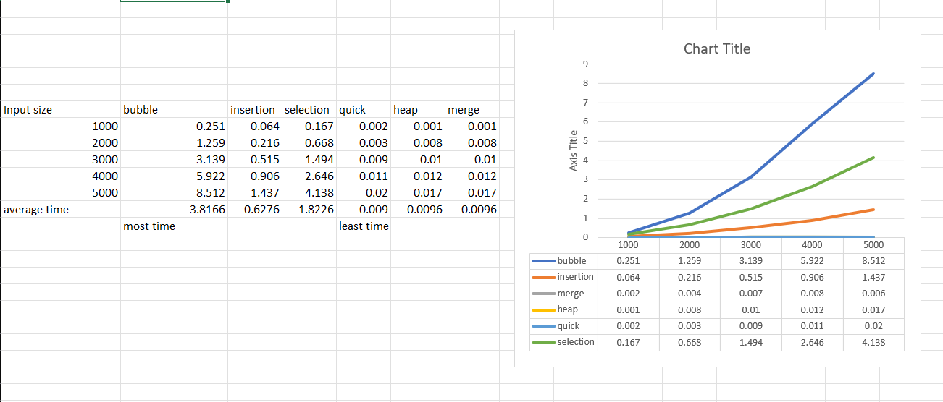
Combined graph
The most efficient method for my given dataset is Quick sort and least efficient is bubble sort

Slide 28
binary search
#include <stdio.h>
#include <stdlib.h>
#include <string.h>
#include <time.h>
#define MAX_LINE_LENGTH 1024
#define MAX_ROWS 50000
int binarySearch(int arr[],int size,int val){
int low=0,high=size-1,mid;
while(low<=high){
mid=(high+low)/2;
if (arr[mid] == val)
{
printf("found");
return mid;
}
else if(arr[mid] < val)
{
low=mid+1;
}
else{
high=mid-1;
} }
return -1;
}
int main() {
FILE *file;
char line[MAX_LINE_LENGTH];
char *column[MAX_ROWS];
clock_t t;
int row_count = 0;
file = fopen("C:\\Users\\nagul\\Desktop\\Data structure\\car50000.csv", "r");
if (file == NULL) {
perror("Error opening file");
return 1;
}

Slide 29
int val;
printf("Enter the Element : ");
t = clock();
scanf("%d",&val);
if(binarySearch(record,n,val)==-1){
printf("Element not found\n");
}
t = clock()-t;
double time_taken = ((double)t) / CLOCKS_PER_SEC;
printf("Time taken: %f seconds\n", time_taken);
return 0;
}
while (fgets(line, sizeof(line), file) != NULL && row_count < MAX_ROWS) {
line[strcspn(line, "\n")] = '\0';
char *token = strtok(line, ",");
if (token != NULL) {
column[row_count] = strdup(token);
row_count++;
}
}
fclose(file);
int n = sizeof(column)/sizeof(column[0]);
char *endptr;
int record[MAX_ROWS];
for (int i = 0; i < row_count; i++) {
int num = strtol(column[i], &endptr, 10);
record[i] = num ;
}

Slide 30
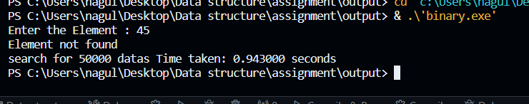
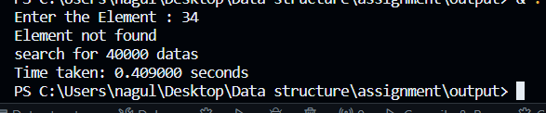
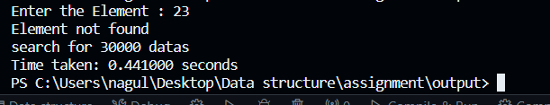
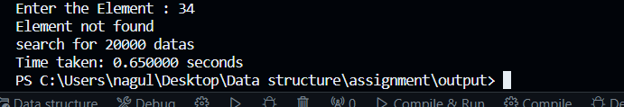
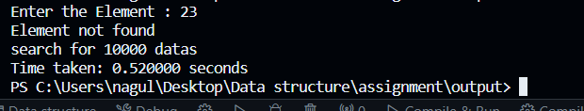
50000 datasets
40000 datasets
30000 datasets
20000 datasets
10000 datasets

Slide 31
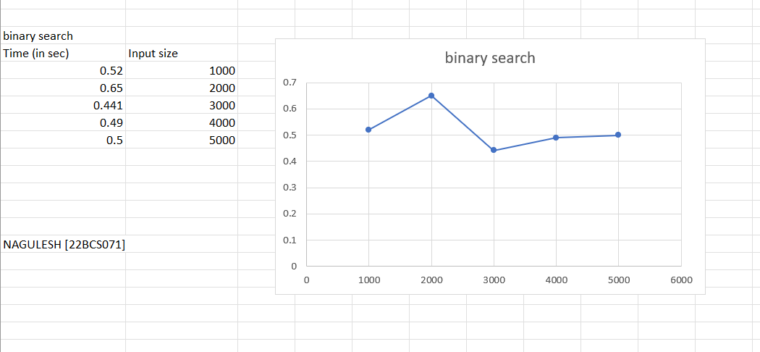
Graph for binary search

Slide 32
linear search
#include <stdio.h>
#include <stdlib.h>
#include <string.h>
#include <time.h>
#define MAX_LINE_LENGTH 1024
#define MAX_ROWS 50000
int linearSearch(int arr[],int size,int val){
for (int i=0;i<size;i++){
if (arr[i]==val){
printf("Found");
return i+1;
}
}
printf("not found");
}
int main() {
FILE *file;
char line[MAX_LINE_LENGTH];
char *column[MAX_ROWS];
clock_t t;
int row_count = 0;
file = fopen("C:\\Users\\nagul\\Desktop\\Data structure\\car50000.csv", "r");
if (file == NULL) {
perror("Error opening file");
return 1;
}

Slide 33
int val;
printf("Enter the Element : ");
t = clock();
scanf("%d",&val);
if(binarySearch(record,n,val)==-1){
printf("Element not found\n");
}
t = clock()-t;
double time_taken = ((double)t) / CLOCKS_PER_SEC;
printf("Time taken: %f seconds\n", time_taken);
return 0;
}
while (fgets(line, sizeof(line), file) != NULL && row_count < MAX_ROWS) {
line[strcspn(line, "\n")] = '\0';
char *token = strtok(line, ",");
if (token != NULL) {
column[row_count] = strdup(token);
row_count++;
}
}
fclose(file);
int n = sizeof(column)/sizeof(column[0]);
char *endptr;
int record[MAX_ROWS];
for (int i = 0; i < row_count; i++) {
int num = strtol(column[i], &endptr, 10);
record[i] = num ;
}

Slide 34
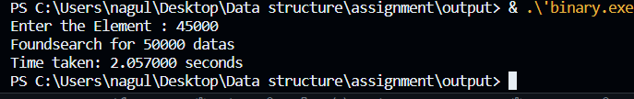
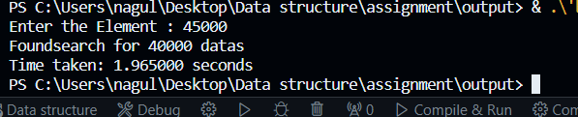
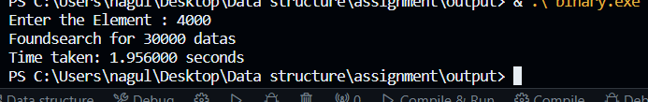
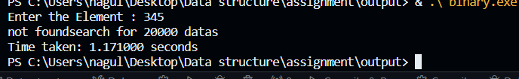
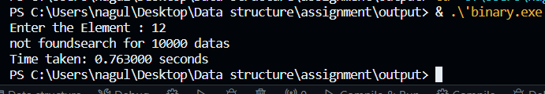
50000 datasets
40000 datasets
30000 datasets
20000 datasets
10000 datasets

Slide 35
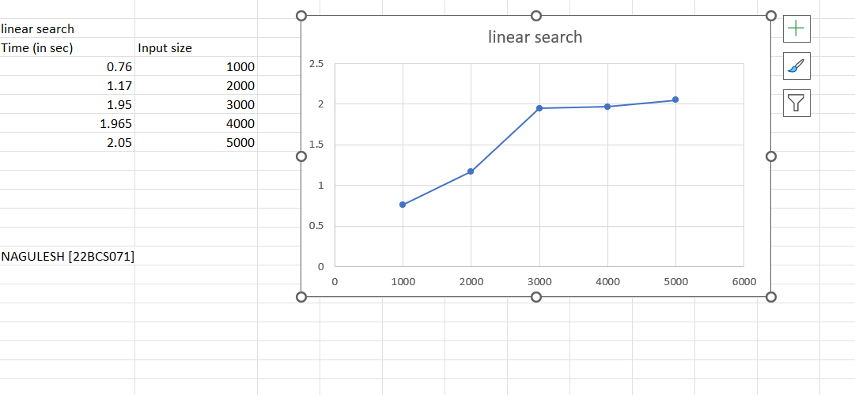
Graph for Linear search

Slide 36

Comparison between linear search and binary search
From the above chart we can conclude that binary search is more efficient than linear search for my dataset
nagulesh 22BCS071.xlsx

Slide 37
Thank you !!!
Nagulesh N [ 22BCS071 ]

